Slide 1

Session 17 (of 24) Intro to JDBC
PGR112 Objektorientert programmering
Yuan Lin / yuan.lin@kristiania.no

Slide 2
Today’s Main Goal
What is JDBC?
Why use JDBC?
How do we use JDBC?
Environment Setup
IntelliJ Setup
A Work Around

Slide 3
What is JDBC?
JDBC stands for Java Database Connectivity
Prerequisite of learning JDBC
You have a good understanding of Java programming
You have basic knowledge about database

Slide 4
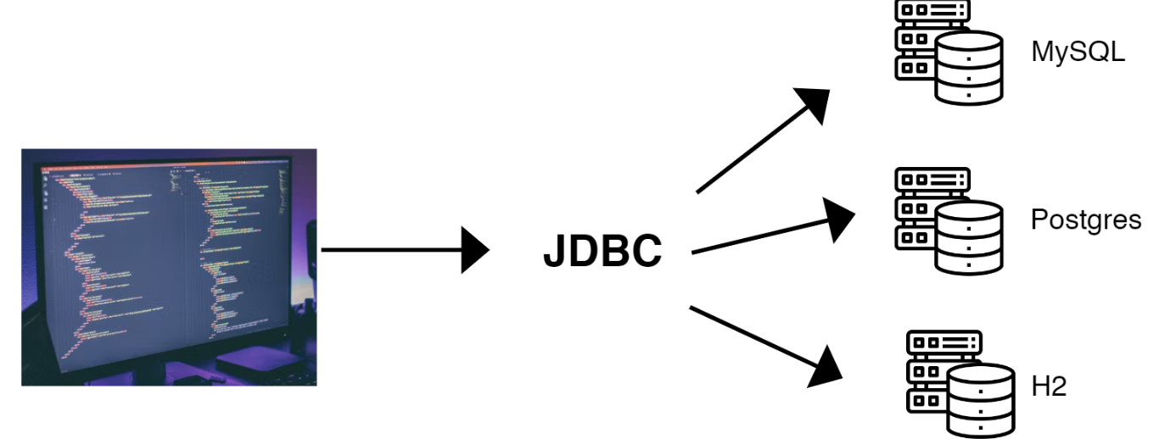
Why JDBC?
You already know how to directly access database
Example: MySQL workbench
What if the Database provider changes technology? Or we want to change Database provider?
Using driver manager is a good practice.

Slide 5
JDBC – Database Connector
Using JDBC
Any changes are handled in the Drivers
Our code can remain the same

Slide 6
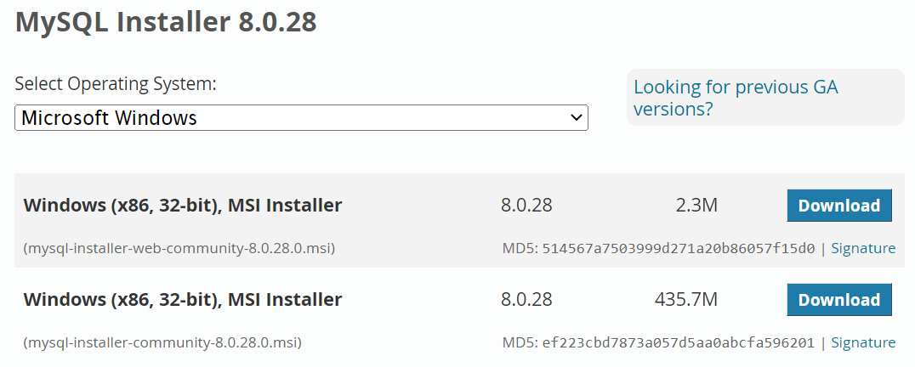
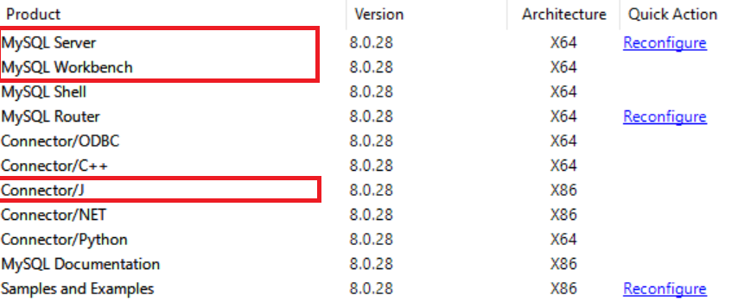
JDBC – A step-by-step approach
You have already installed MySQL server. If not, go to https://dev.mysql.com/downloads/installer/, download MySQL installer community which eases your MySQL product installation and configuration.
Make sure that you have installed MySQL server, Connector/J
Make sure that you have the right permissions, access, users, etc.
How?

Slide 7
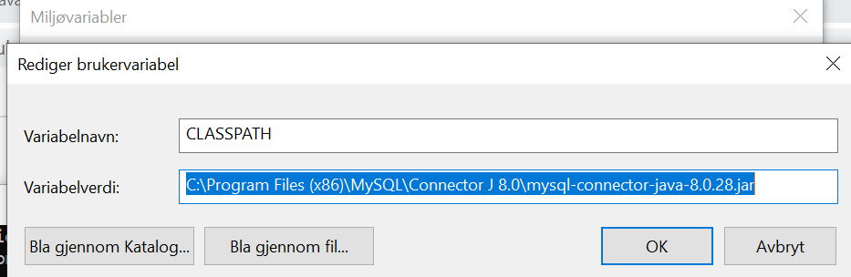
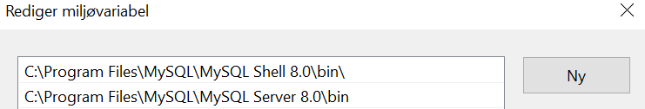
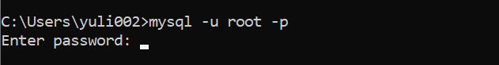
MySQL ENV Setup
Go to Miljøvariable
Step #1: Add CLASSPATH in Brukervariabler. The url value is where you have installed Connector/J.
Step #2: Add the path to MySQL Server 8.0\bin to Path variable. The path depends on which version you have installed.
Step #3: Go to cmd window, type mysql –u root –p, and enter password. You have set pwd for root when you installed server.

Slide 8
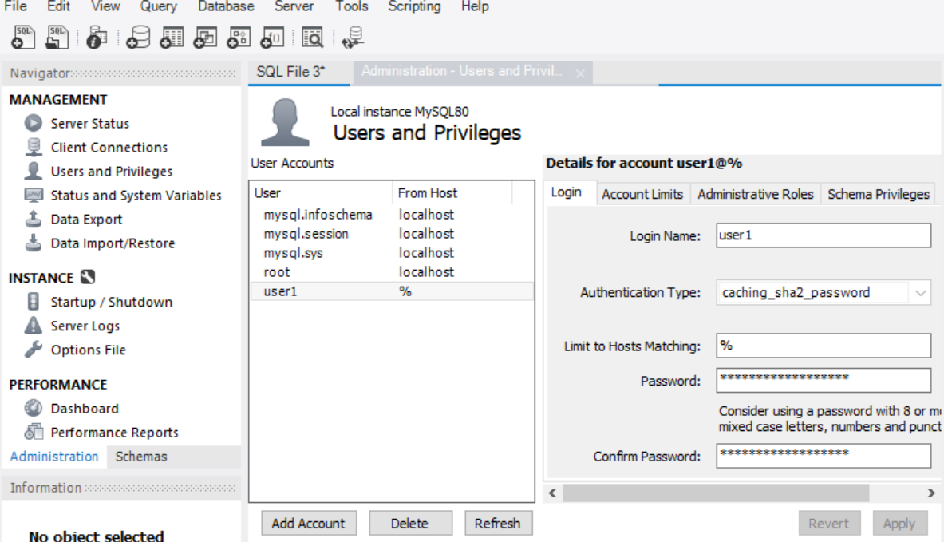
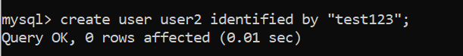
MySQL ENV Setup – cont.
Create a new user. You can do it either from MySQL workbench GUI, or from cmd window.
Create user from workbench GUI. Click Add Account
Create user from cmd window.

Slide 9
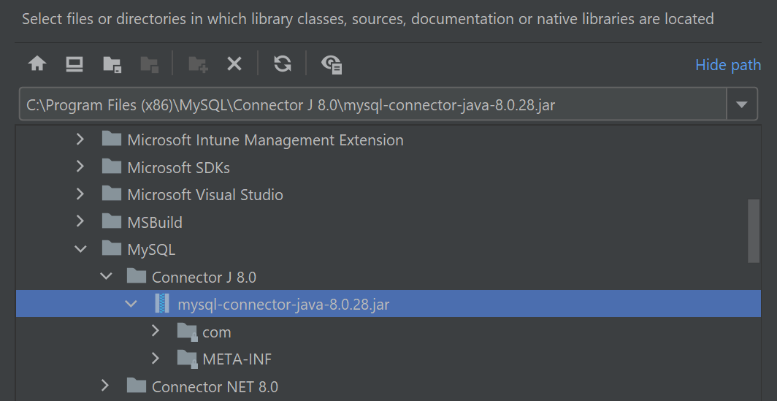
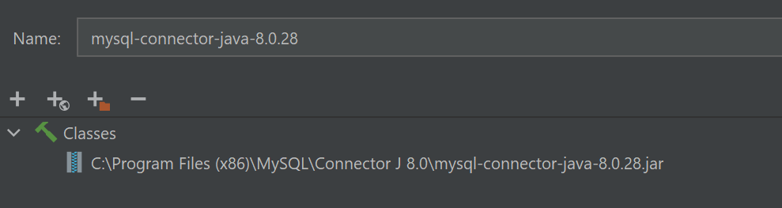
IntelliJ ENV Setup
Add a JDBC connect
Add the mysql-connector-java-8.0.28.jar from File->Project Structure->Libraries
If you are using Maven for project settings, you can choose add from Maven.
Now we are ready for JDBC

Slide 10
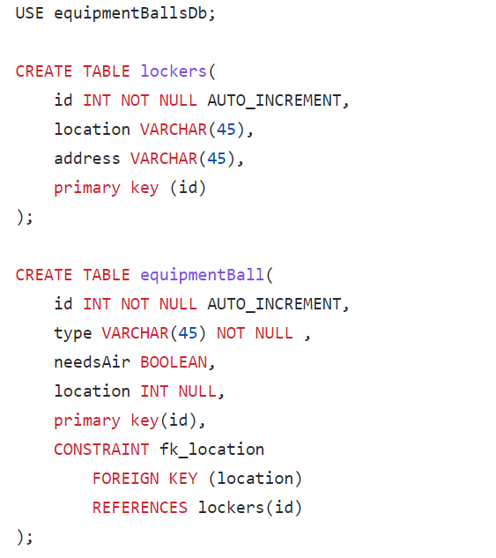
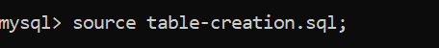
Run Scripts from CMD
Before we jump to JDBC, we can try to interact directly with Database using mysql command.
In Session17.resources.sql, you will find some sql scripts (e.g., for creating and dropping tables)
Download the sql scripts and source them.
Note that it is the same as you run scripts from workbench…

Slide 11
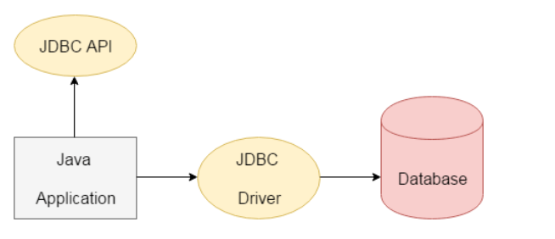
JDBC API?
Run scripts from cmd window and interact directly with database is fine. But…
We want to programmatically interact with database such as
Create DB
Create tables
Add objects
Drop objects
Update objects
…
With the help of JDBC API, we can save, update, delete and fetch data from the database.
From javatpoint

Slide 12
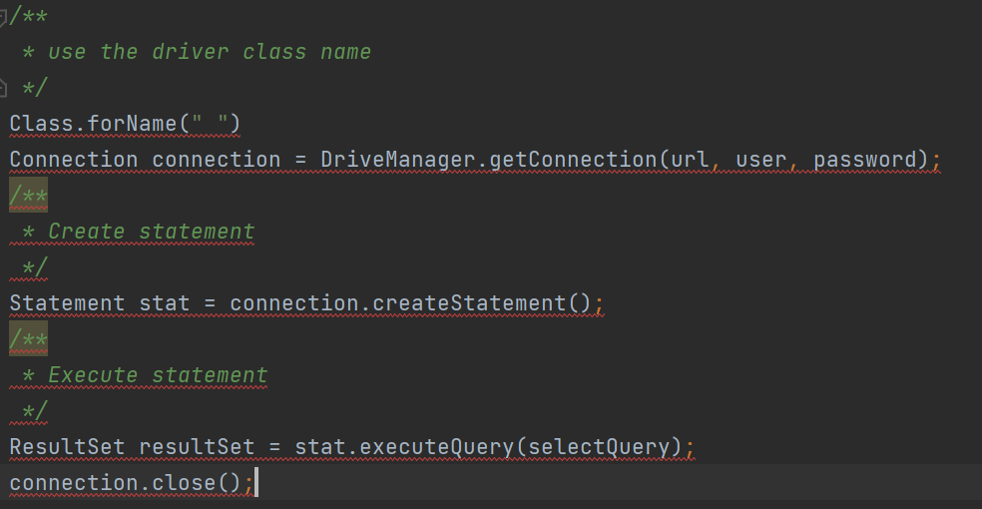
Basic Steps of using JDBC connections
Step #1: Register the Driver class
Step #2: Set up the connection
Step #3: Create Statement
Step #4: Execute Query
Step #5: Close the connection object

Slide 13
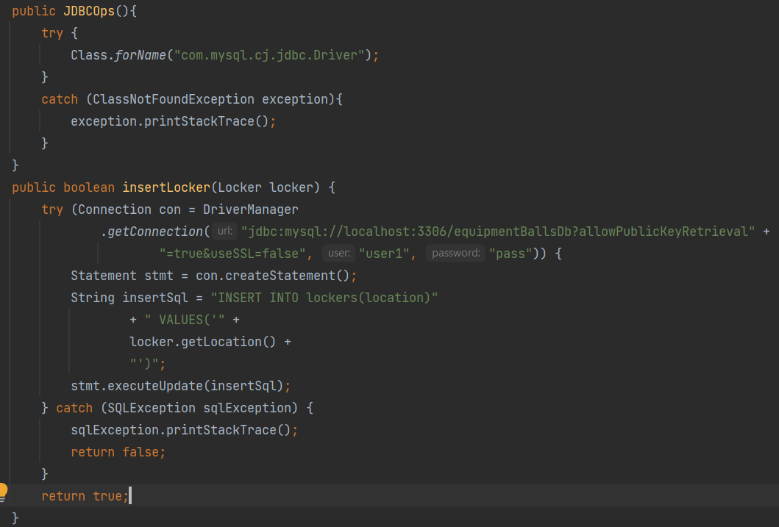
Basics of JDBC interaction with a database
java.sql.Connection – handle a connection to a database
java.sql.DriverManager – the means of getting a Connection object (in Java , everything is an object)
The code on the right shows steps #1-5 of interacting with mysql database.

Slide 14
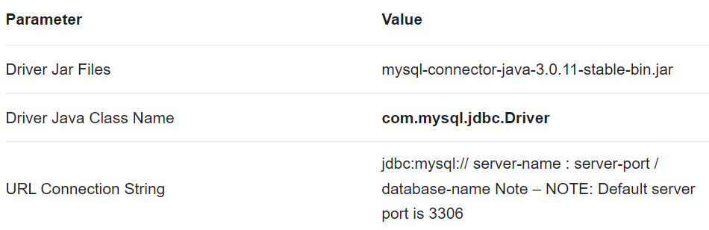
Basics of JDBC interaction with a database
MySQL Connector/J Driver configuration properties
https://docs.oracle.com

Slide 15
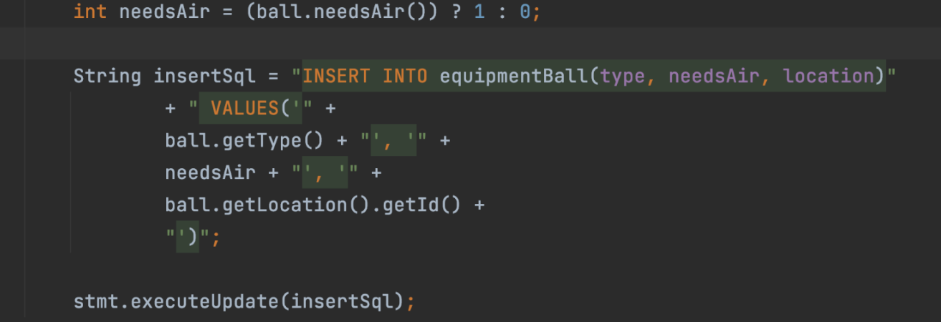
Creating a query programmatically
You know about queries:
INSERT INTO persons (name, address) VALUES (‘John’, ‘1’)
What if we want to insert a particular object?

Slide 16
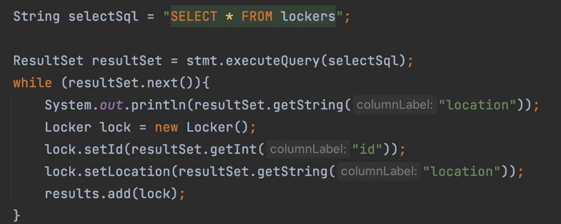
Creating a query programmatically
You know about queries:
SELECT * FROM …
What if we want to push the result into an array?

Slide 17
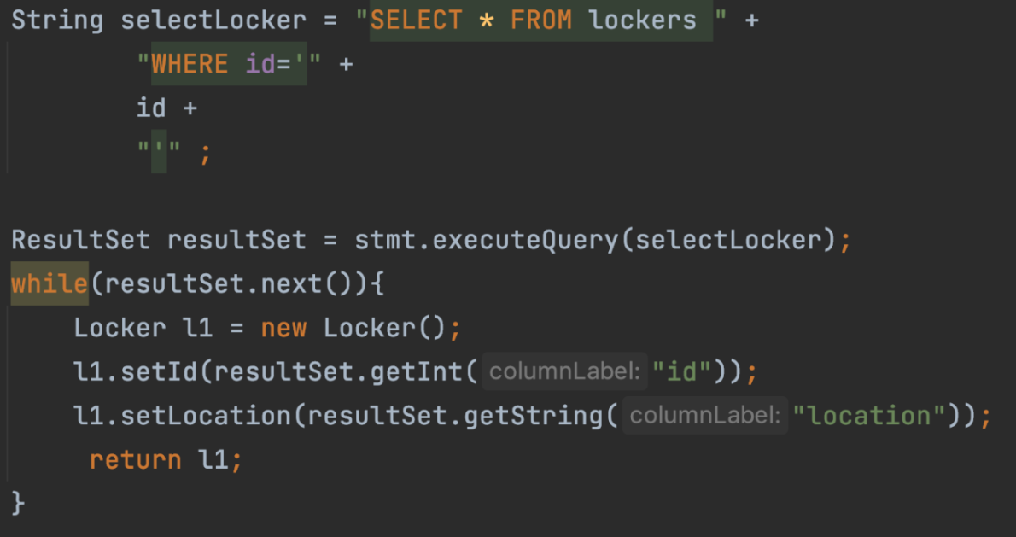
Creating a query programmatically
You know about queries:
SELECT * FROM … WHERE id = …
What if we want to query programmatically?

Slide 18
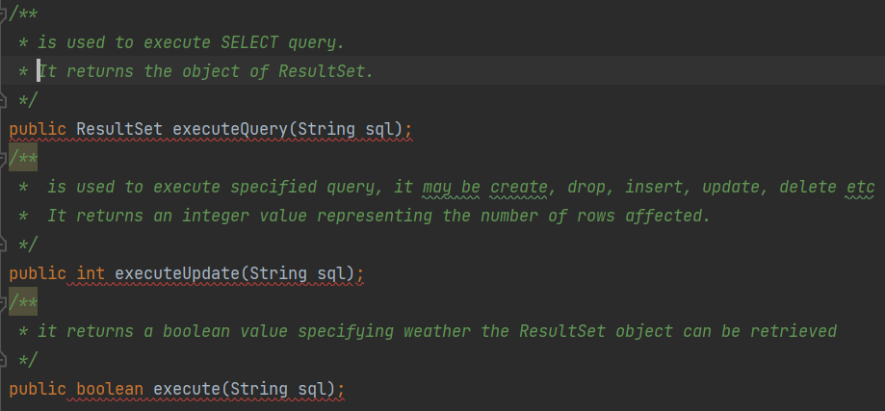
Statement Interface
Statement interface provides metrhods to execute queries with the database.
Commonly used methods of Statement interface include:

Slide 19
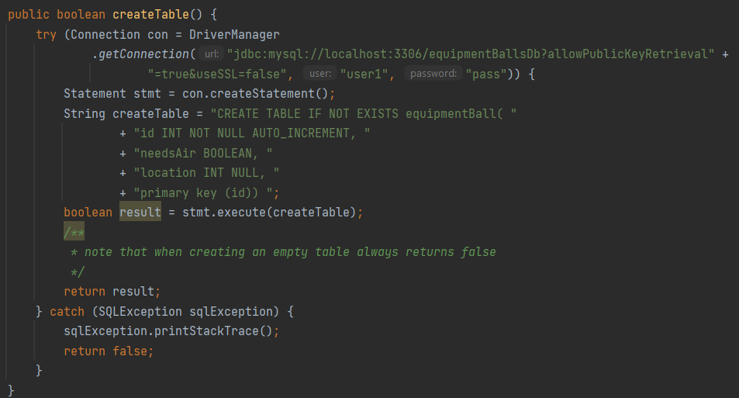
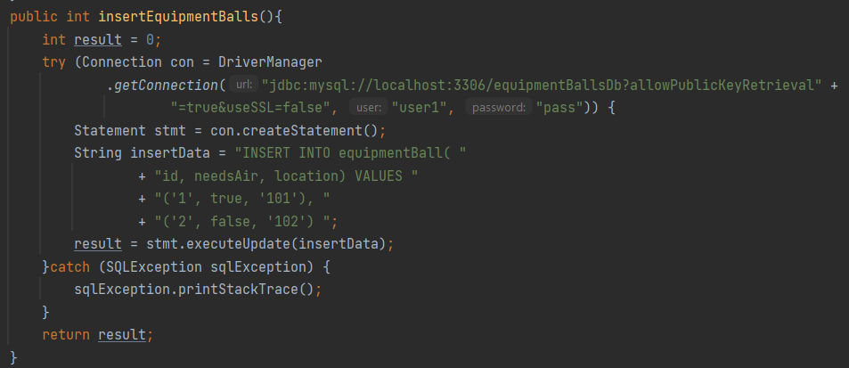
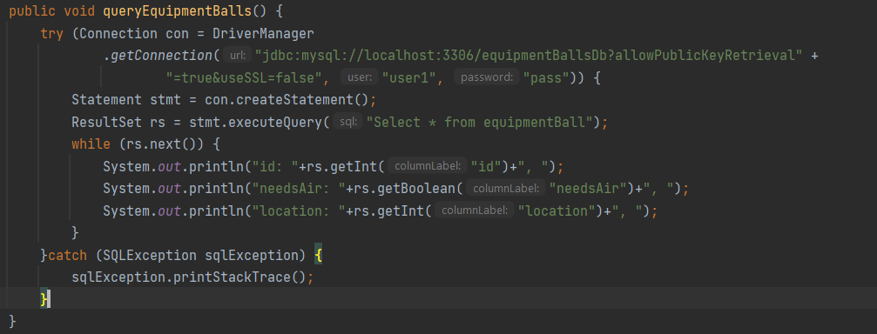
The major difference between execute(), executeQuery(), and executeUpdate()
executeQuery() returns the object of ResultSet
executeUpdate() returns an integer representing number of rows affected
execute() returns a boolean value specifying whether the retulsSet object can be retrieved.

Slide 20
ResultSet Interface
A ResultSet object maintains a cursor that points to the current row in the result set.
The methods of the ResultSet interface can be broken down into 3 categories:
Navigational methods – use to move the cursor around
Get methods – Used to view the data in the columns of the current row
Update methods – Used to update the data in the columns of the current row
JDBC provides the following connection methods to create statements with desired ResultSet
createStatement(int RSType, int RSConcurrency);
prepareStatement(String SQL, int RSType, int RSConcurrency);
prepareCall(String sql, int RSType, int RSConcurrency);
Which we will introduce in later lectures!

Slide 21
Conclusion
JDBC is an API that allows a program to connect to a Database
JDBC allows the program itself to be agnostic of the underlying technology used
We canuse JDBC API to do following tasks:
Connect to the database
Run queries and update statements against the database
Obtain the outcome of the database query.

Slide 22
Before we end
You know how to create a DB Connection, and use it to interact with a DB
You know how to create a query
You know how to execute a query
You know how to handle the retrieved ResultSet

